Slide 1
Circuit Control Over Internet
Internet Of Things

Slide 2
Agenda of this presentation
About My – Self
Basic concept about IoT
Project Demonstration
Little bit of implementation ( if you are willing to be bored ) … ☺

Slide 3

Sabbir Ahmed Shourov
Study
BSc in Computer Science & Engineering
4th year, Student
American International University Bangladesh (AIUB)
Higher Secondary School & Secondary School
Saidpur Govt Technical School & College
Saidpur, Nilphamary
Work
GUI Design & Implementation, Hardware & Software Interface
AIUB Robotic crew – 2017
Social Info
Facebook -> fb.com/extinctCoder
Twitter -> @extinctCoder
Github -> github.com/extinctCoder

Slide 4
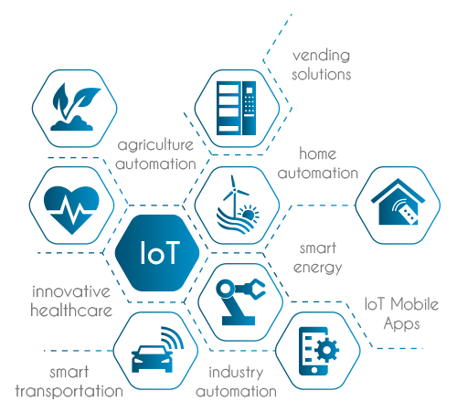
What is IOT?
The Internet of Things (IoT) is the network of physical objects—devices, vehicles, buildings and other items embedded with electronics, software, sensors, and network connectivity—that enables these objects to collect and exchange data.

Slide 5

Try this out …

Slide 6
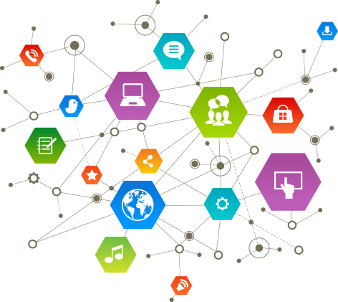
Enabling Technologies
Tagging things
Feeling things
Shrinking things
Thinking things

Slide 7

The IoT Market
As of 2013, 9.1 billion IoT units
Expected to grow to 28.1 billion IoT devices by 2020
Revenue growth from $1.9 trillion in 2013 to $7.1 trillion in 2020

Slide 8
Project Architecture

Slide 9
Things are needed to build the system
Software requirements
Hardware requirements
Visual studio
.NET Framework (getter then 3.5)
NuGet Package manager
MySql.Data Framework
Arduino4net Framework
MaterialDesignThemes
Firmata
Arduino IDE
Xampp
PHP V-5
MySql Database
phpStrom
Arduino UNO or Arduino Mega
Laptop
Relay
Bread board
Jumpers

Slide 10
NuGet PM install command for Frameworks
MySql.Data
Install-Package MySql.Data -Version 6.10.4
Arduino4Net
Install-Package Arduino4Net -Version 0.0.3
MaterialDesignThemes
Install-Package MaterialDesignThemes -Version 2.3.1.953

Slide 11
Software download links
Visual Studio
https://www.visualstudio.com/thank-you-downloading-visual-studio/?sku=Community&rel=15
Arduino IDE
https://downloads.arduino.cc/arduino-1.8.4-windows.exe
phpStrom
https://www.jetbrains.com/phpstorm/download/download-thanks.html?platform=windows
Xampp
https://www.apachefriends.org/xampp-files/5.6.31/xampp-win32-5.6.31-0-VC11-installer.exe

Slide 12
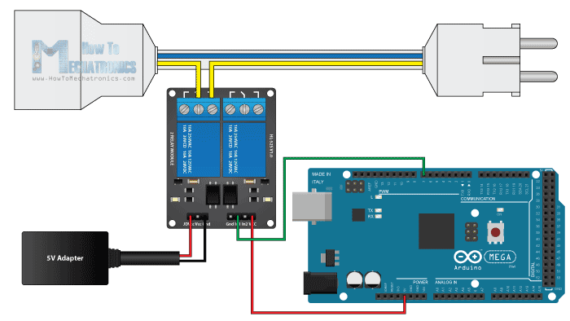
Relay
A relay is an electrically operated switch. Many relays use an electromagnet to mechanically operate a switch, but other operating principles are also used, such as solid-state relays. Relays are used where it is necessary to control a circuit by a separate low-power signal, or where several circuits must be controlled by one signal. The first relays were used in long distance telegraph circuits as amplifiers: they repeated the signal coming in from one circuit and re-transmitted it on another circuit. Relays were used extensively in telephone exchanges and early computers to perform logical operations.

Slide 13

Arduino
Arduino Uno is a microcontroller board based on the ATmega328P (datasheet). It has 14 digital input/output pins (of which 6 can be used as PWM outputs), 6 analog inputs, a 16 MHz quartz crystal, a USB connection, a power jack, an ICSP header and a reset button.
The Arduino Mega is a microcontroller board based on the ATmega1280 (datasheet). It has 54 digital input/output pins (of which 14 can be used as PWM outputs), 16 analog inputs, 4 UARTs (hardware serial ports), a 16 MHz crystal oscillator, a USB connection, a power jack, an ICSP header, and a reset button.

Slide 14
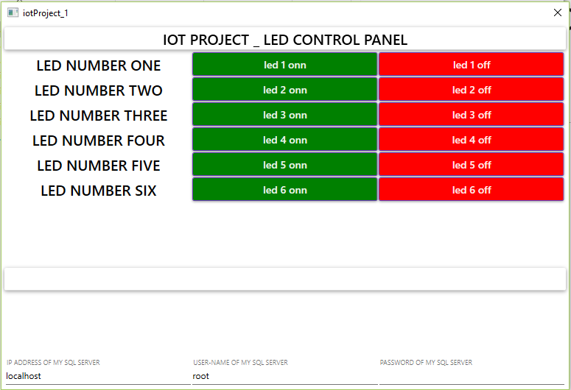
Desktop Control Interface

Slide 15
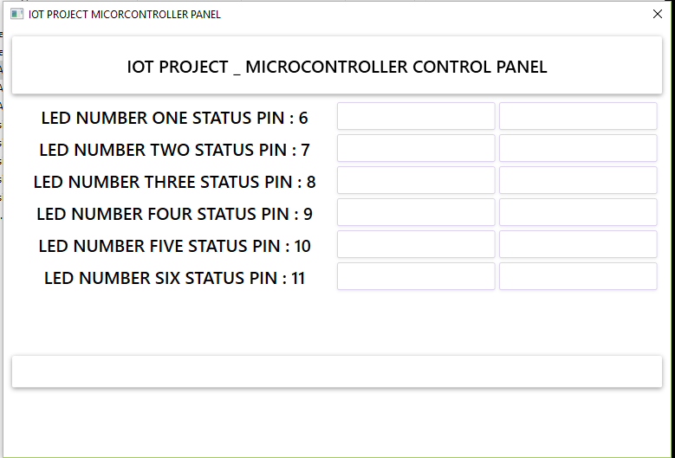
Arduino driver interface

Slide 16
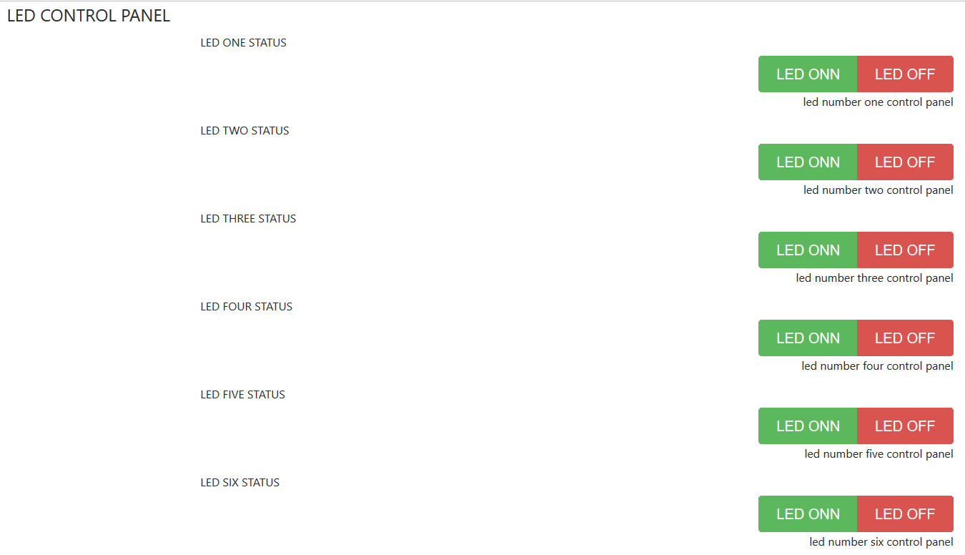
Web Control Panel Interface

Slide 17
Demonstration
Thank you for being bored with me … :P

